Slide 1
Red Cross Blood Drive with
Bern National Honor Society
Congratulations!
52 Units collected

Slide 2
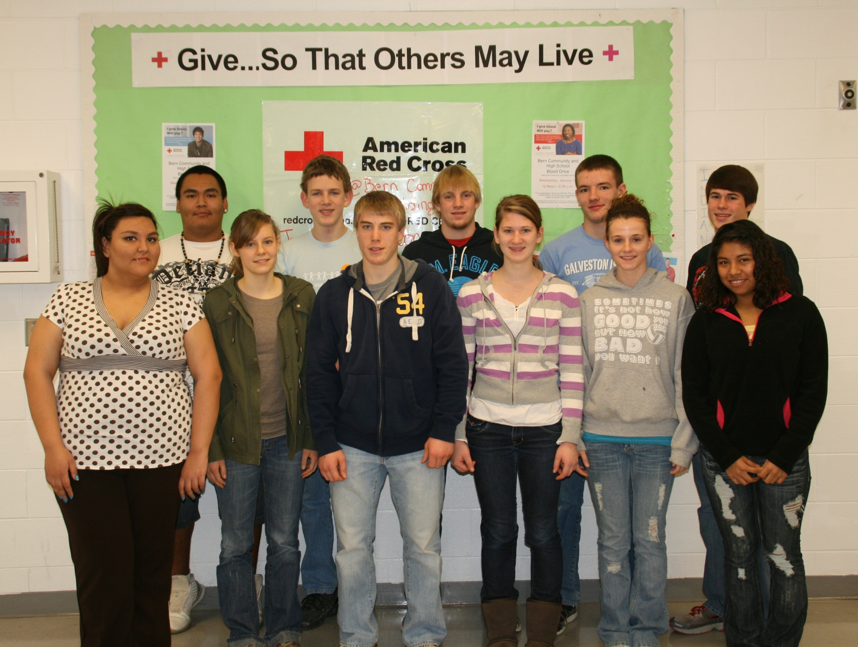
Bern Student Donors

Slide 3
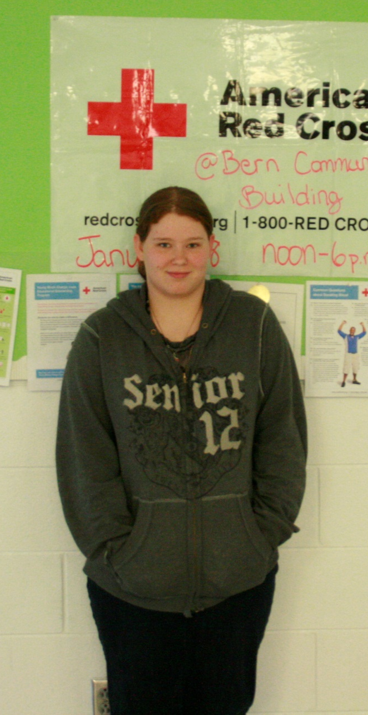
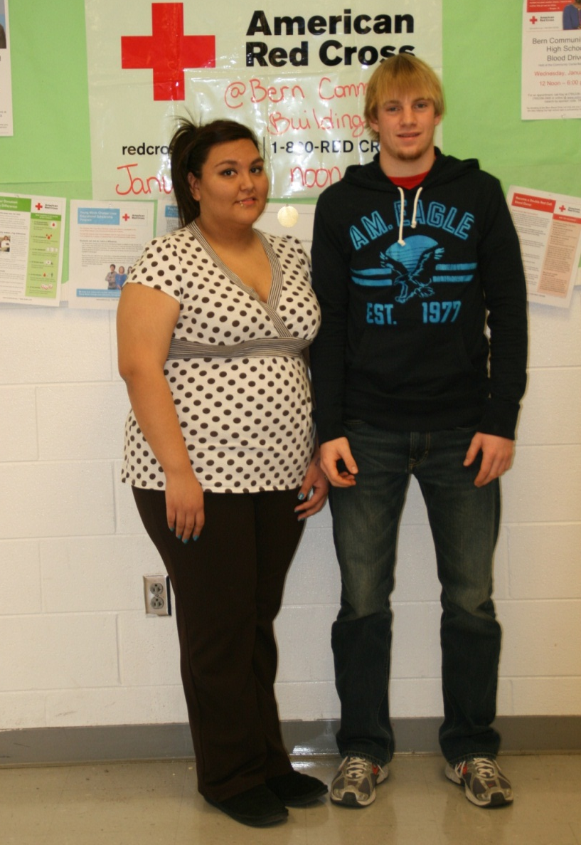
Senior Donors:
Myra Martinez
&
Darren Meyer
&
Nroh Wykert

Slide 4
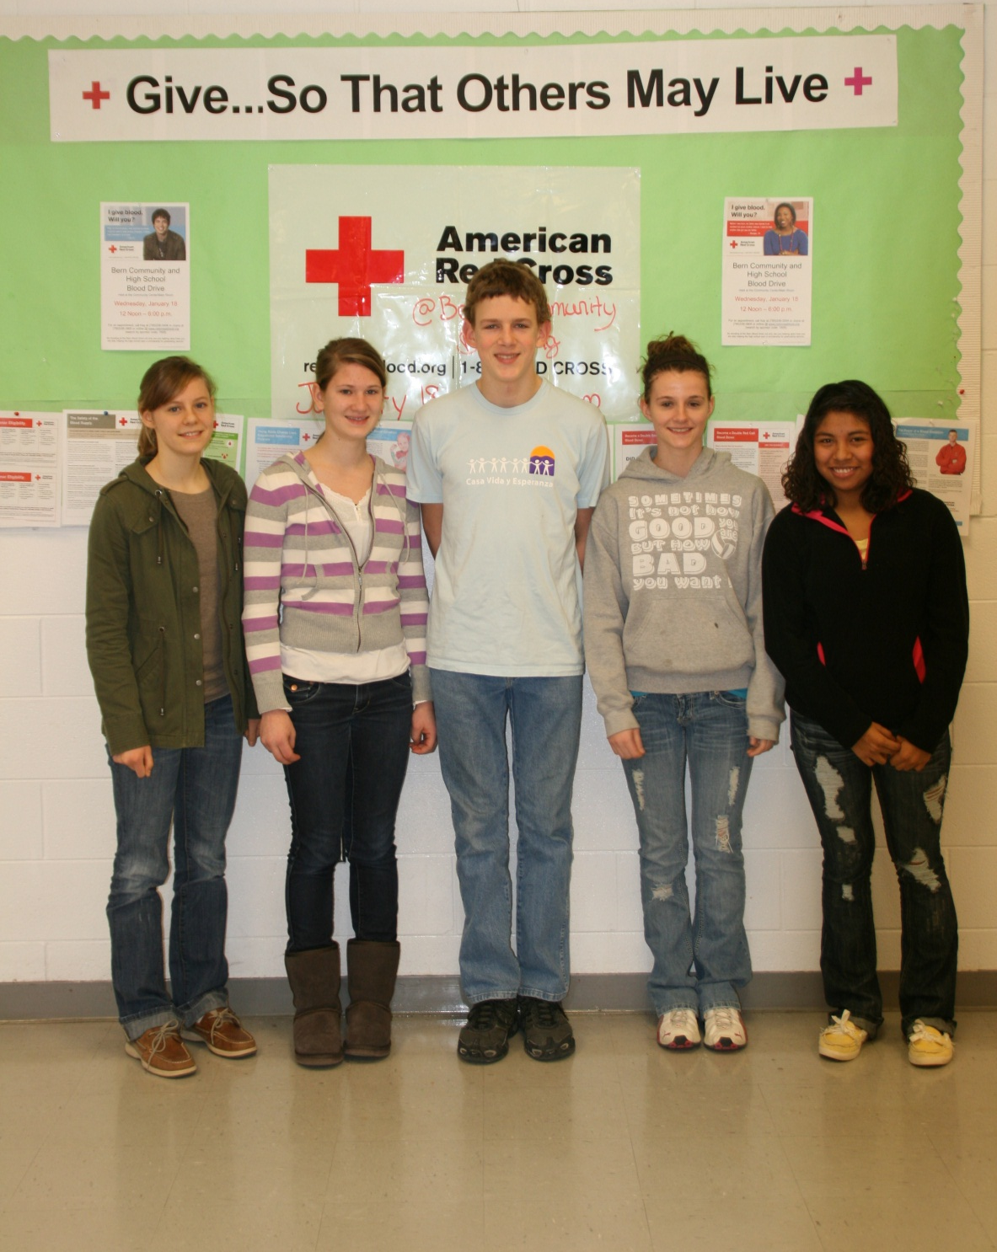
Juniors respond to the challenge !

Slide 5
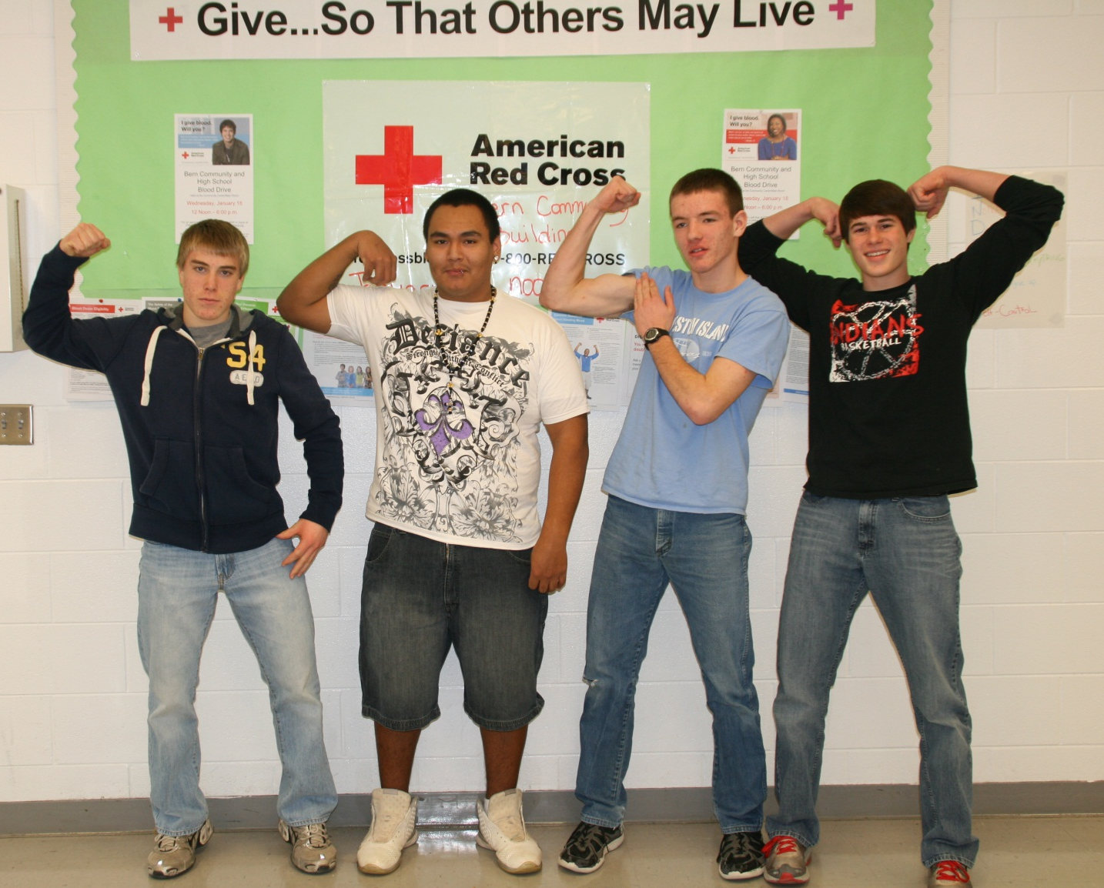
First time donors:
Sophomore boys representin’

Slide 6
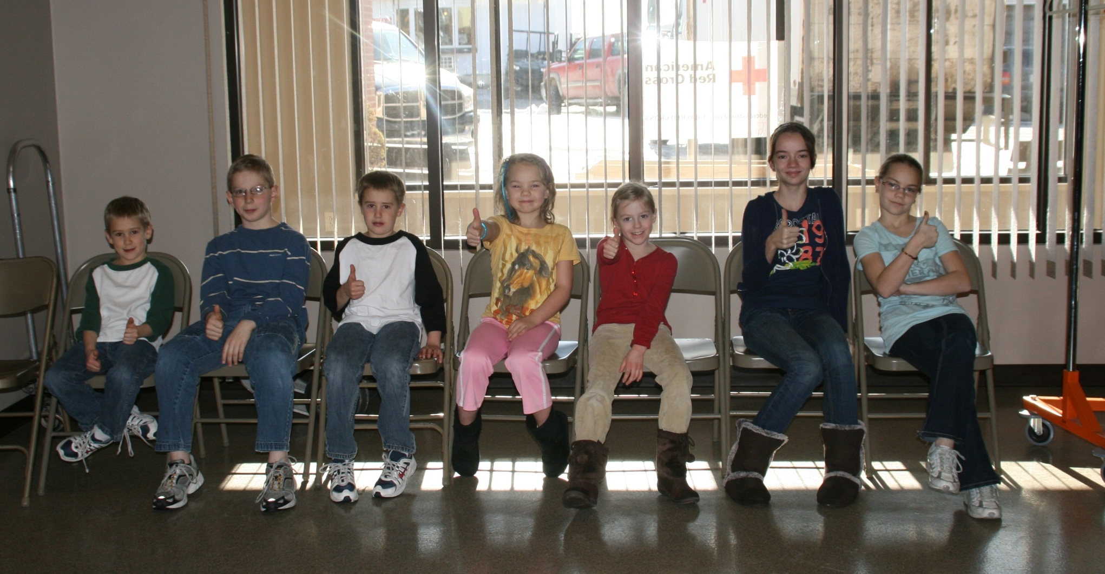
Pint-Sized Heroes !

Slide 7
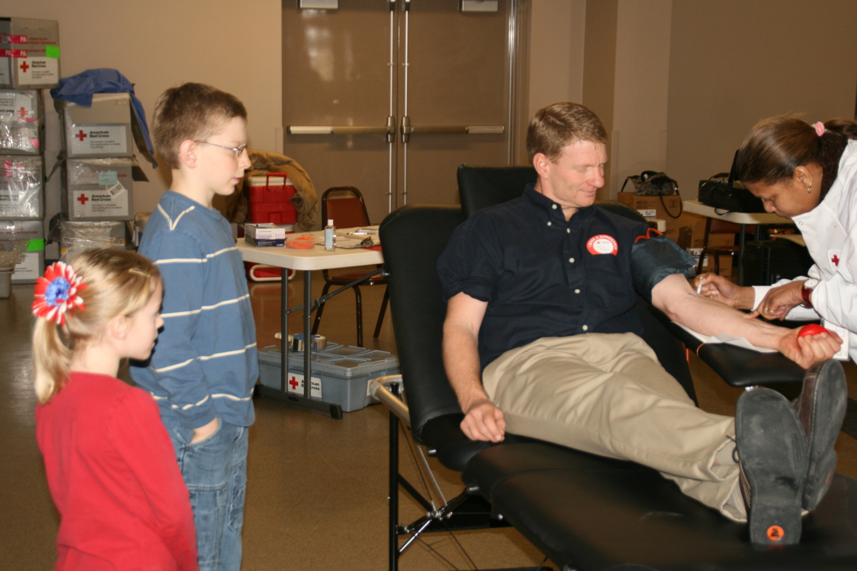
Brenna & Trenton count each drop donated by dad & (math teacher) Mr. Meyer

Slide 8
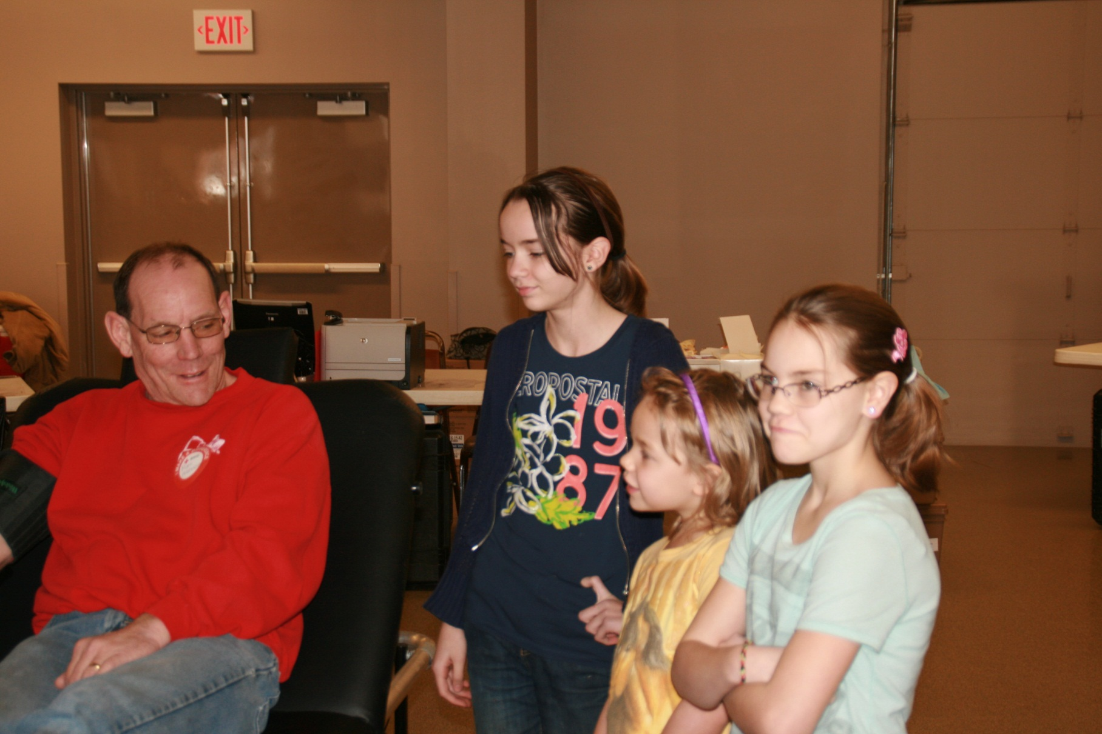
The Haverkamp girls (Riley, Sarah, Rebecca) offer Dad encouraging words.

Slide 9
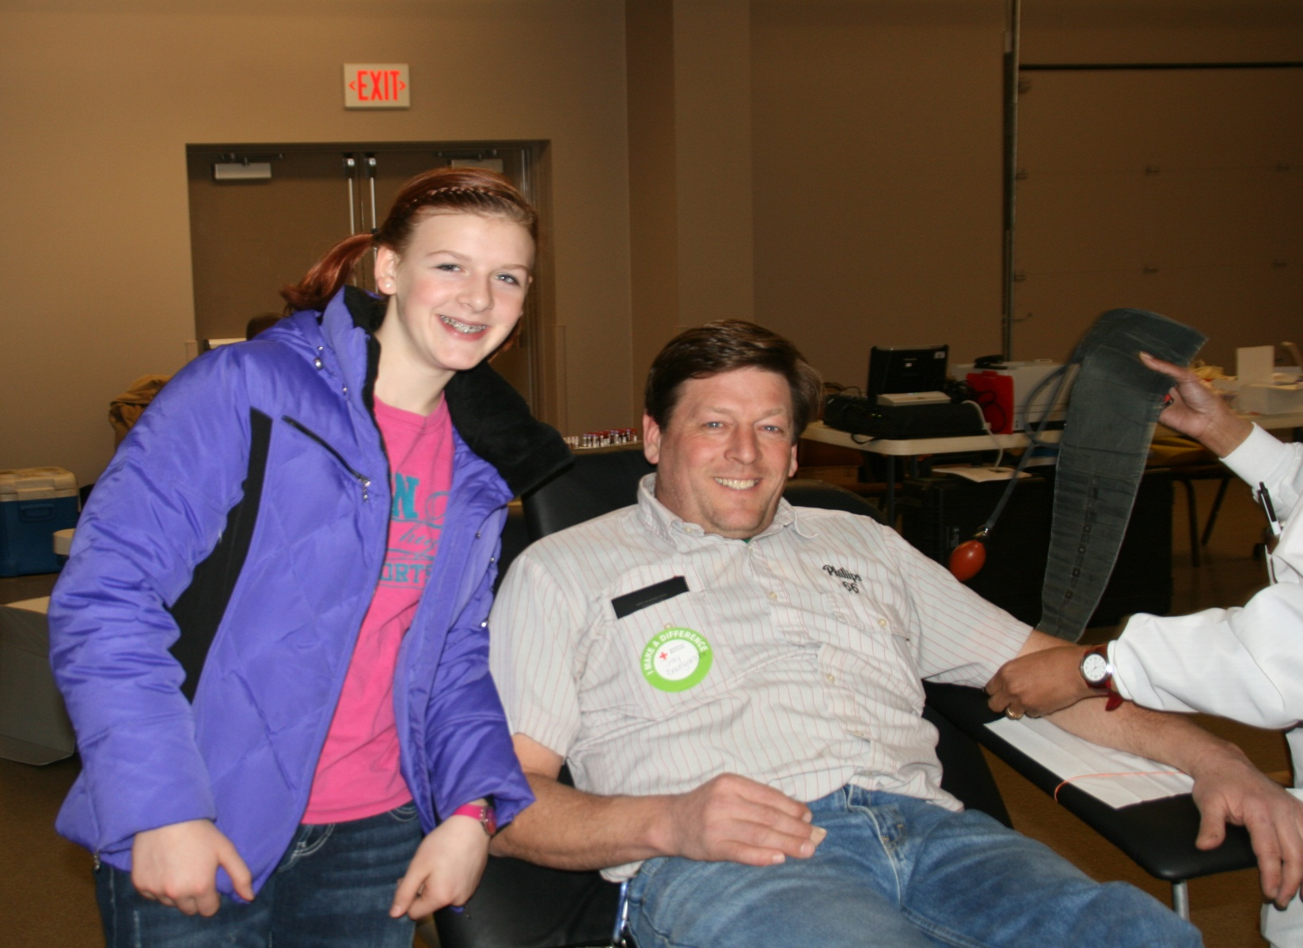
New donor Jay’s all smiles with daughter Rachael by his side!

Slide 10
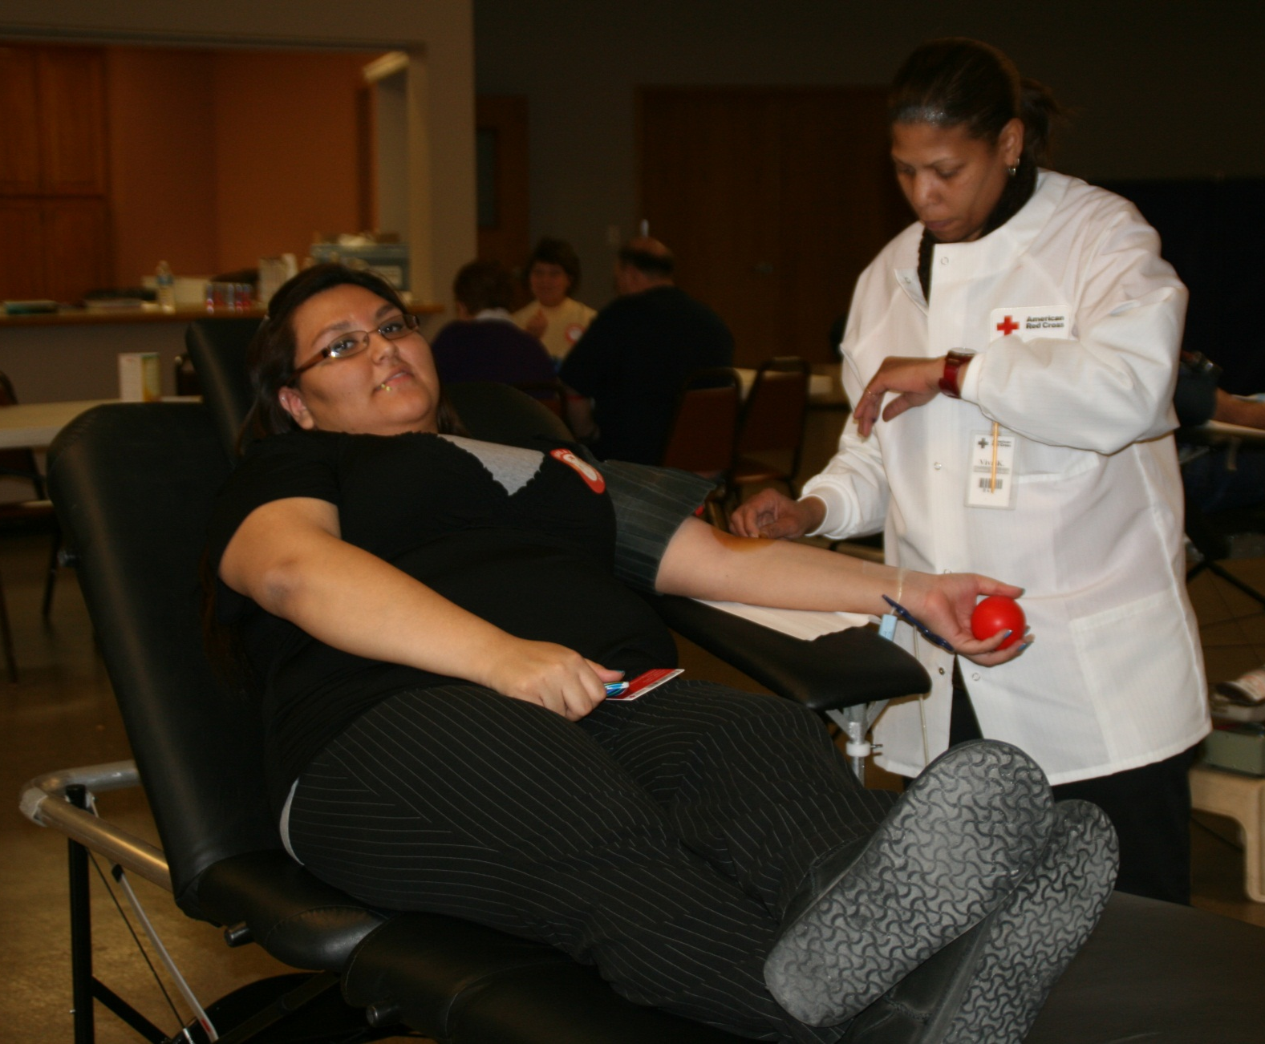
Relax. I’ve done this before- it’s a snap!

Slide 11
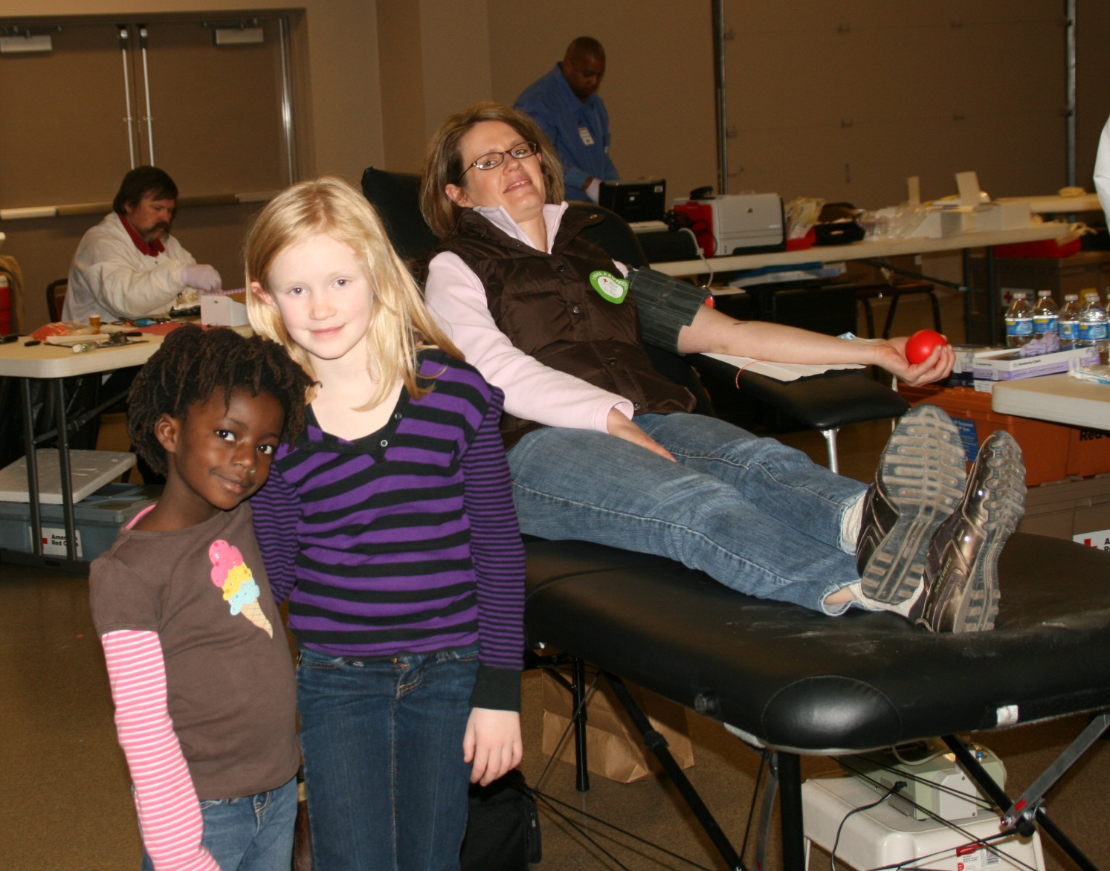
It’s a Mother – Daughter Donor Date!
Megan & Emily & Mom Strahm

Slide 12
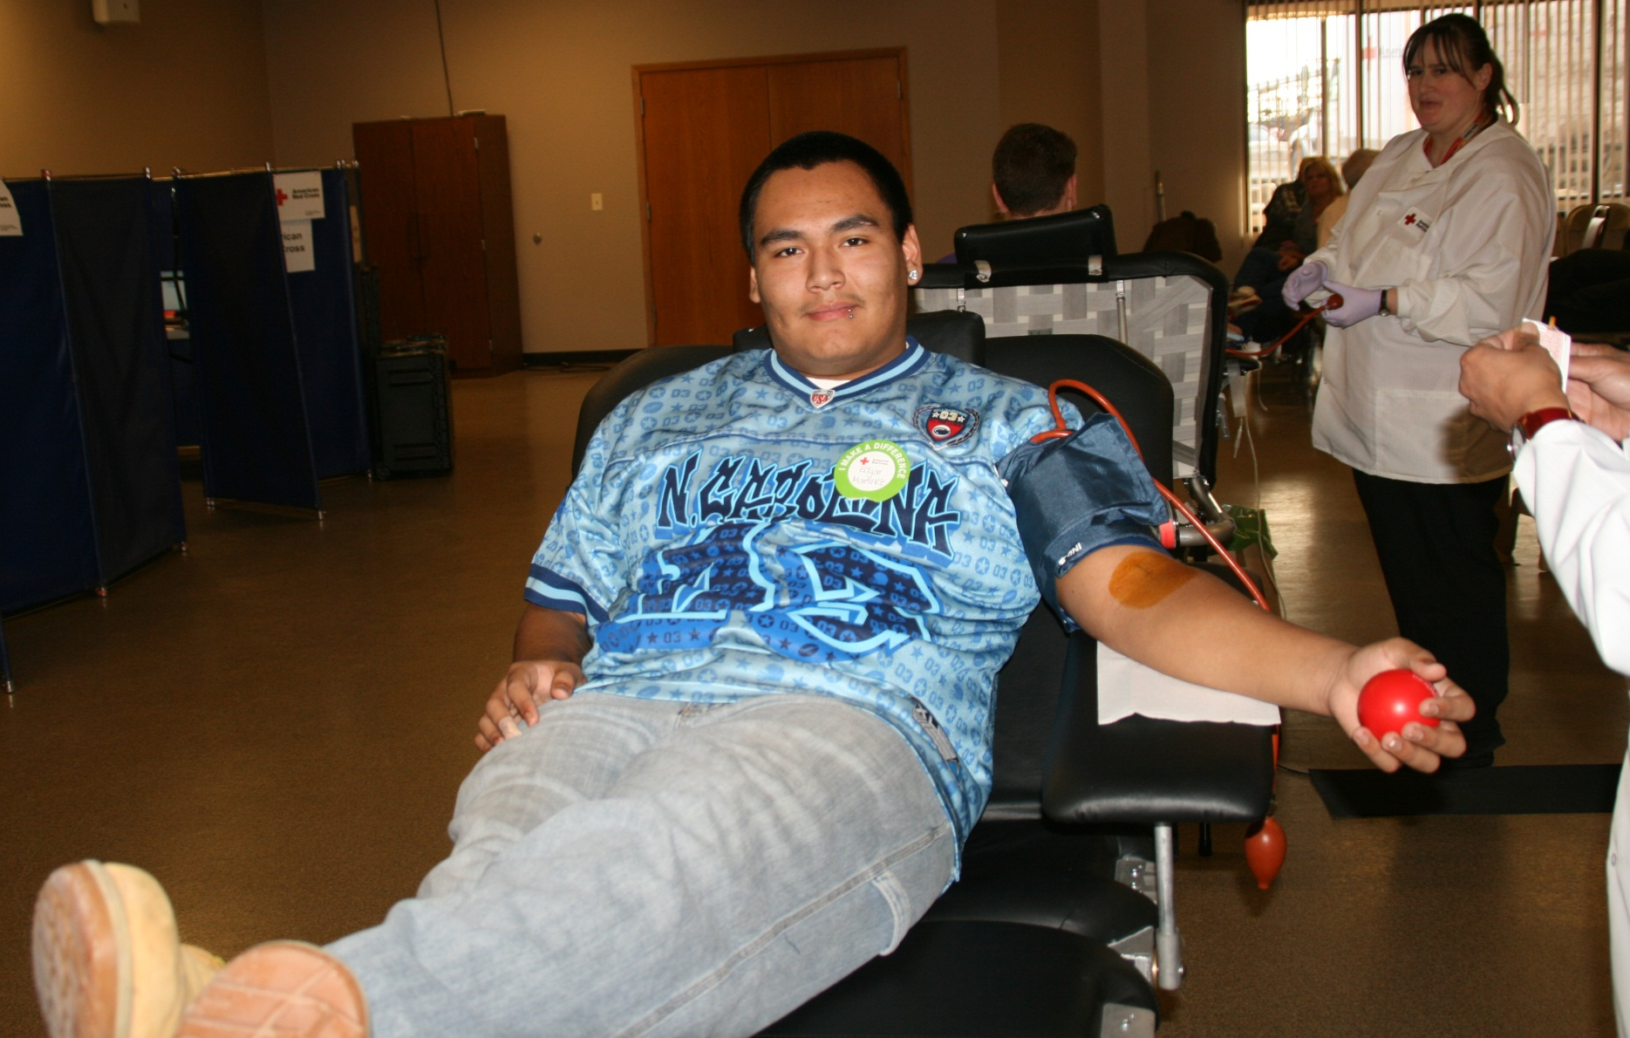
Edgar: Stress-Free !

Slide 13
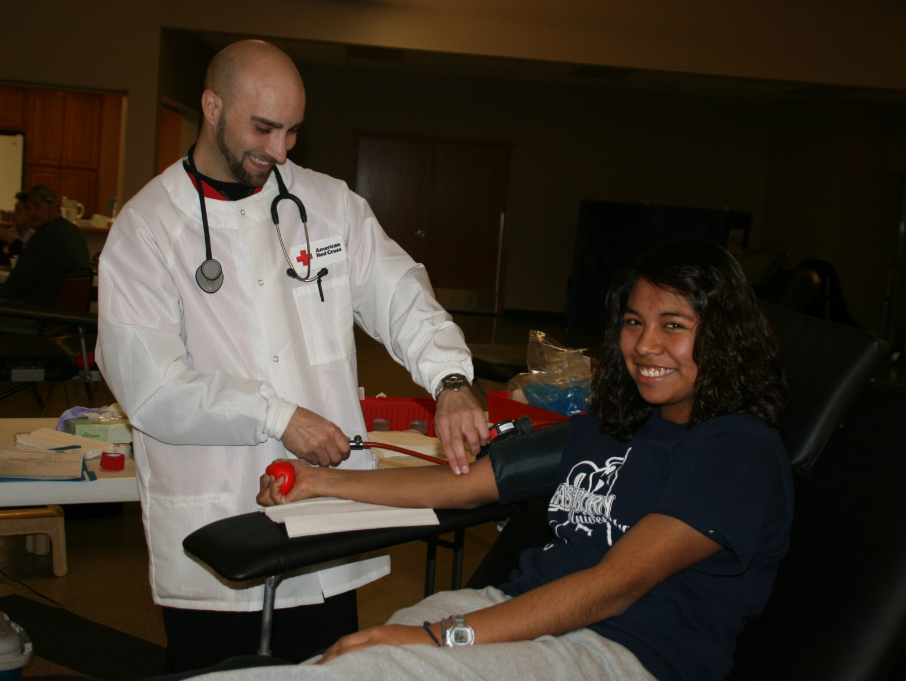
Emma- don’t be Bashful !

Slide 14
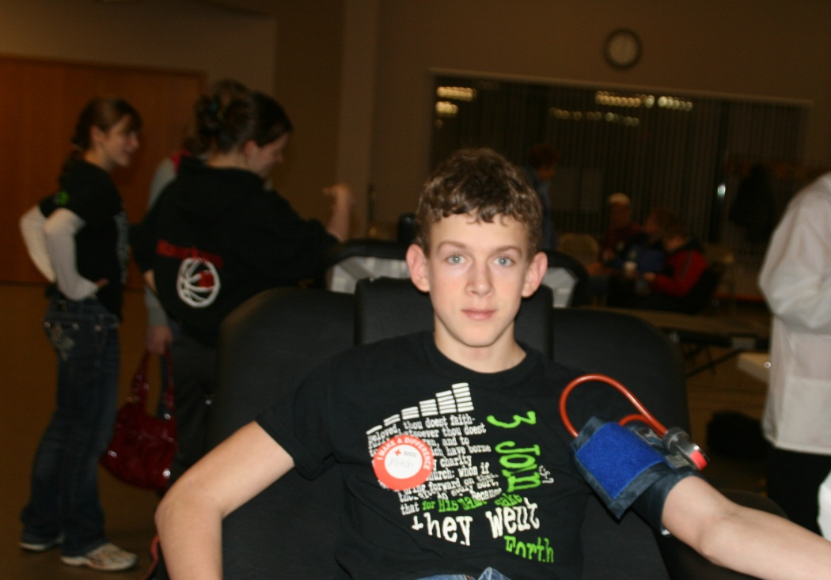
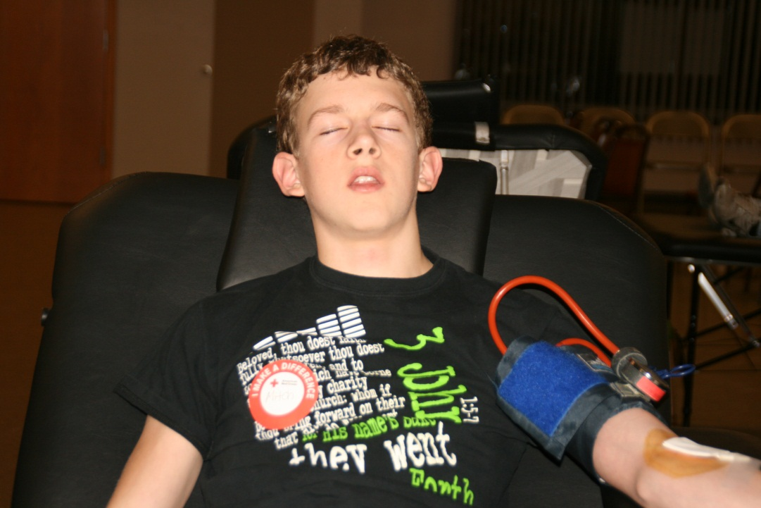
Mitch: Before & After!

Slide 15
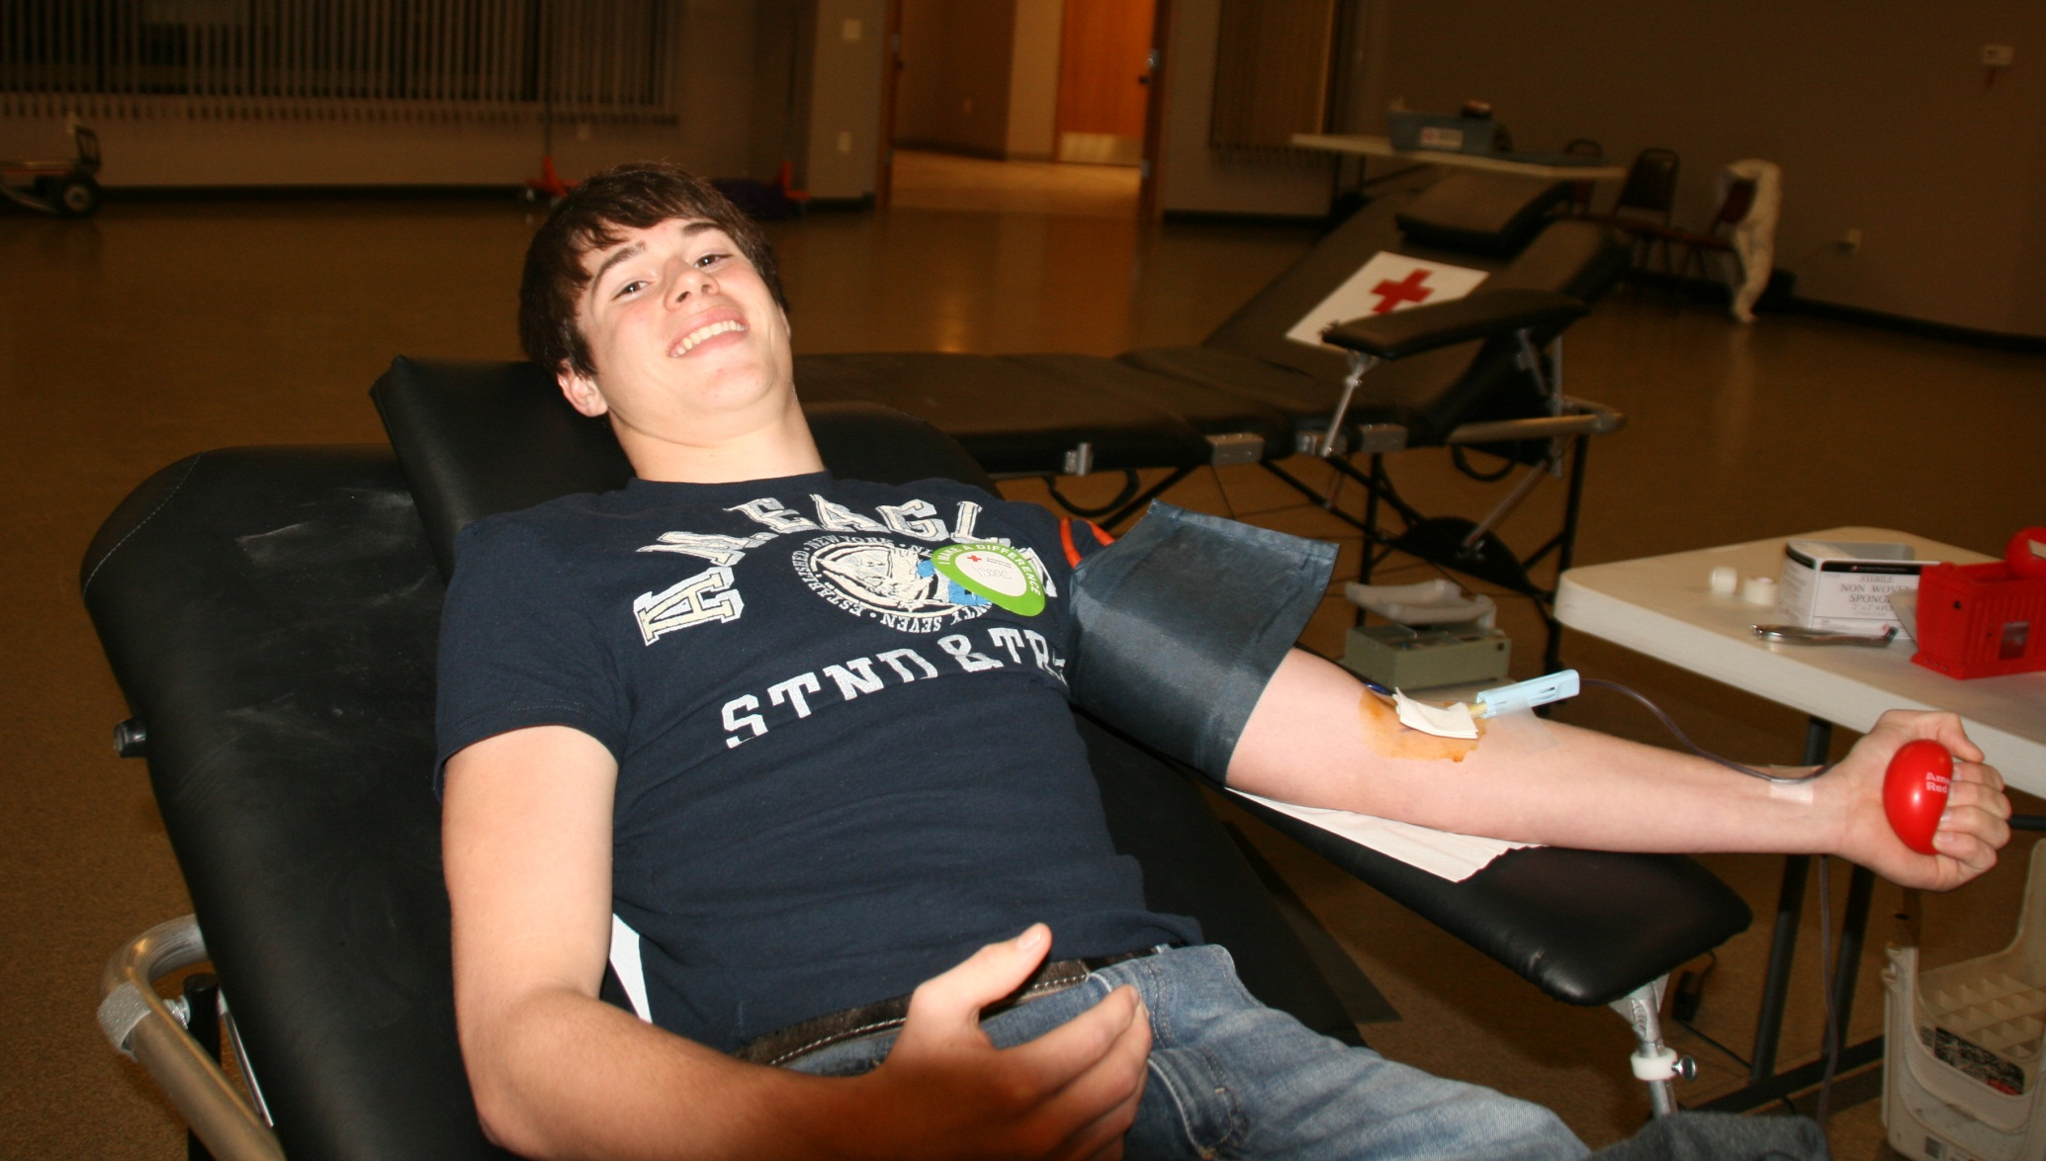
Isaac: Death-Grip on the Ball !

Slide 16
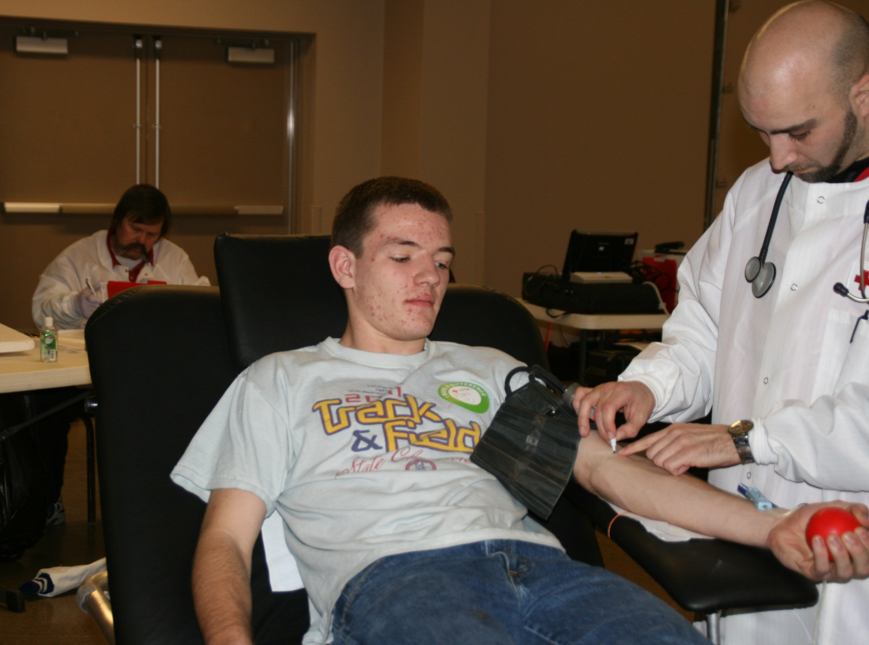
Matt keeps a watchful eye on each step of the procedure.

Slide 17
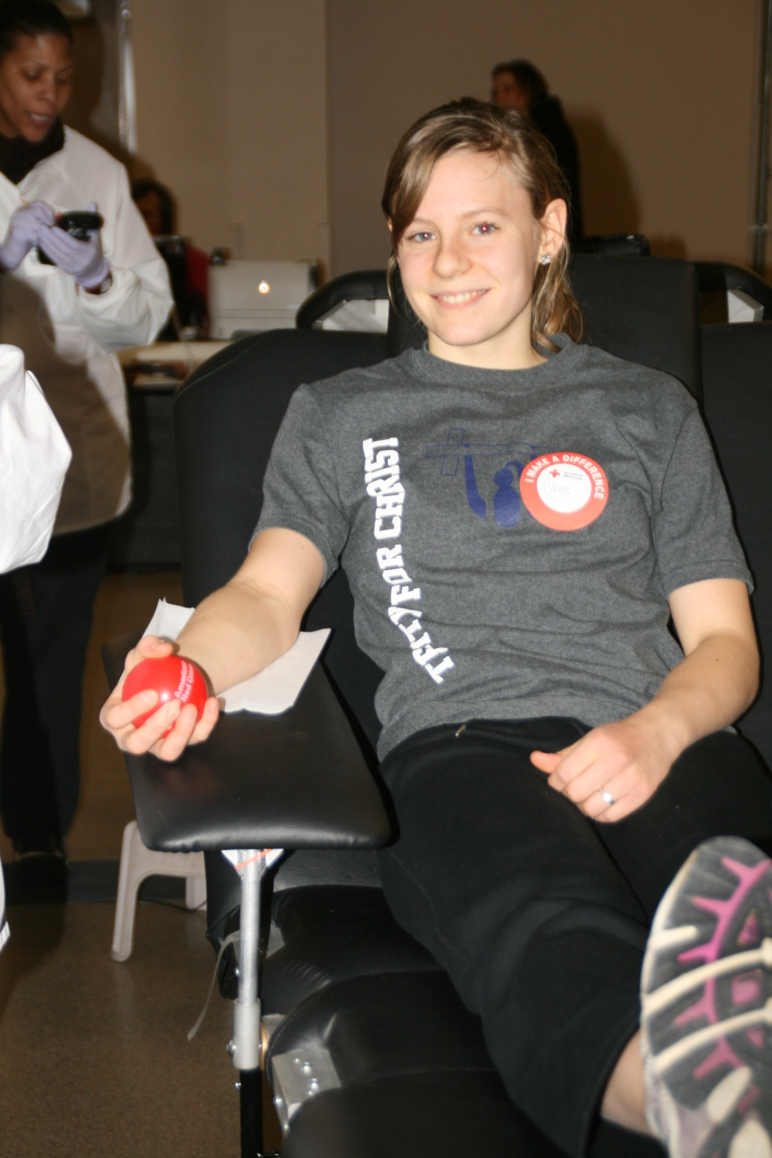
Claire:
Calm; Collected;
Cool as a Cucumber!

Slide 18
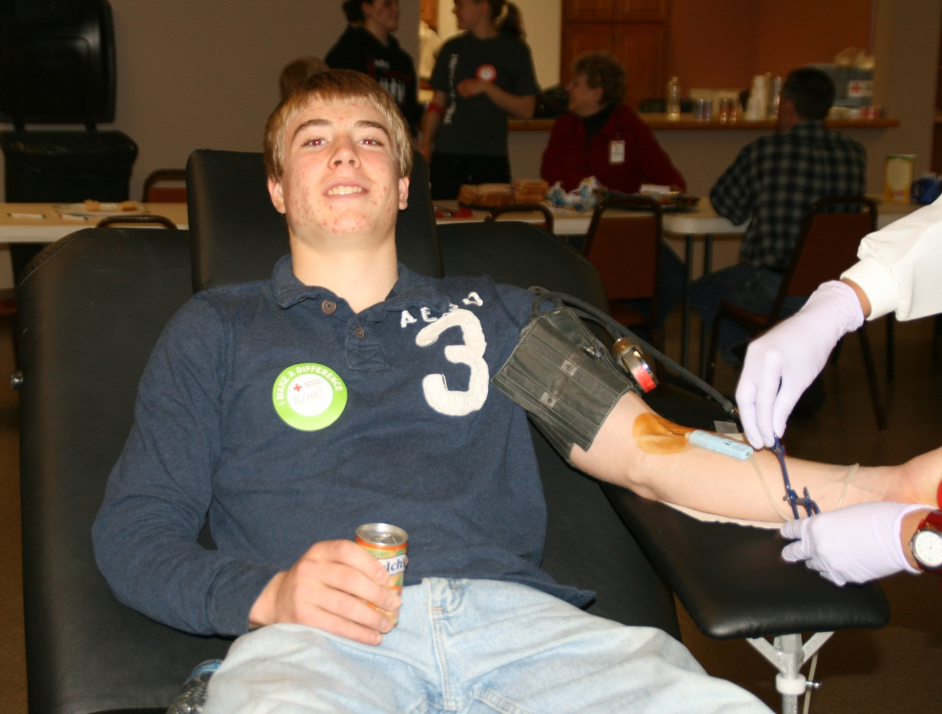
Nothing flusters Michael

Slide 19
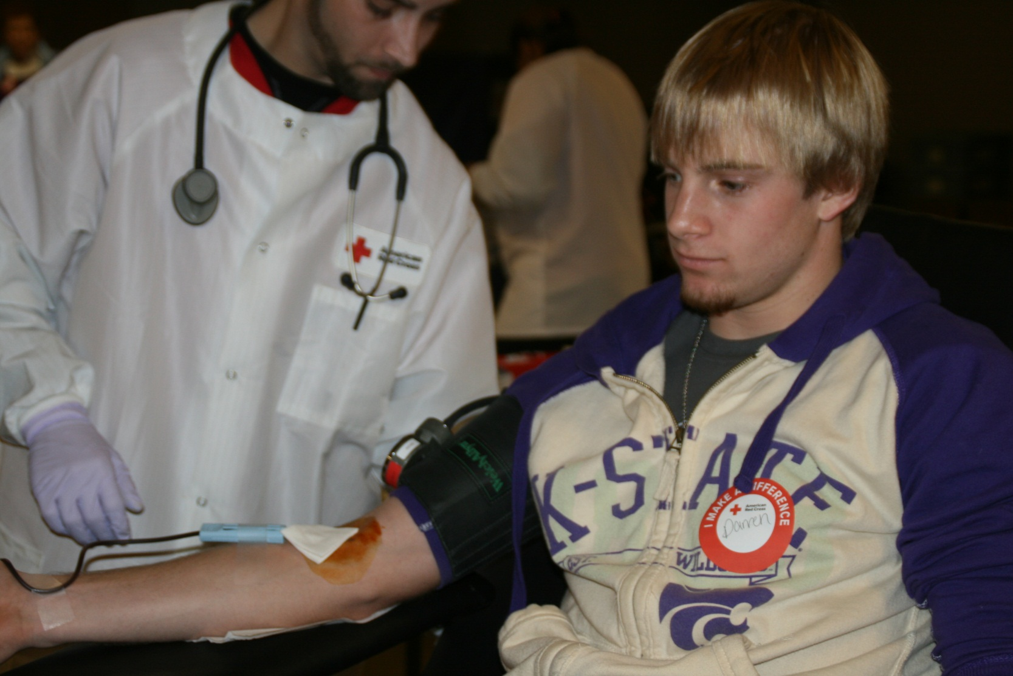
Darren: EMAW !

